Slide 1
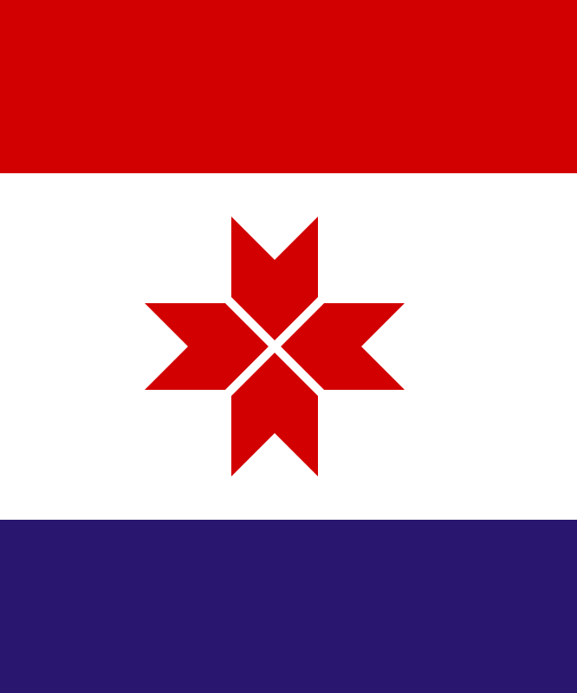
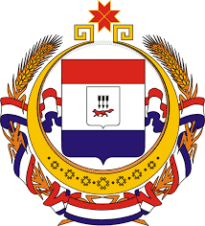
The Republic of Mordovia
My grandparents' homeland:
Mordovia is a republic in the Russian Federation.
It is located in the very center of European Russia.
Our neighbors: Nizhny Novgorod, Ulyanovsk, and Penza regions, and the Republic of Chuvashia.
Symbols of The Republic of Mordovia:
The Flag:
- A white, red, and dark blue tricolor.
White is for purity, red is for strength and courage, dark blue is for beauty and greatness. In the center, there is a sun sign, a symbol of life and prosperity.
The Coat of Arms:
It features a red fox.
The fox is a smart and clever animal. It is a symbol of the wisdom and inventiveness of the people. The red color is the color of life, joy, and beauty.

Slide 2
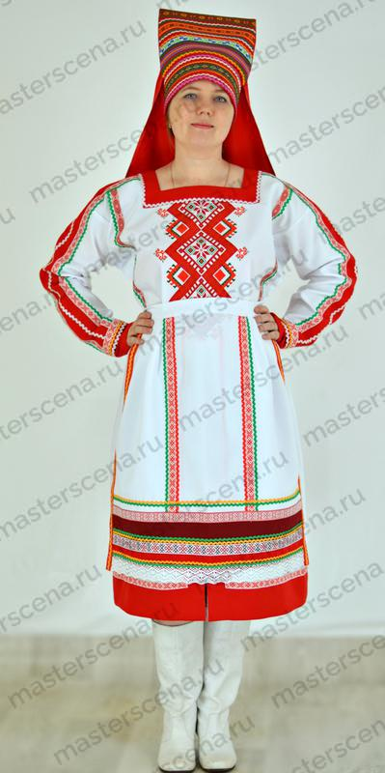
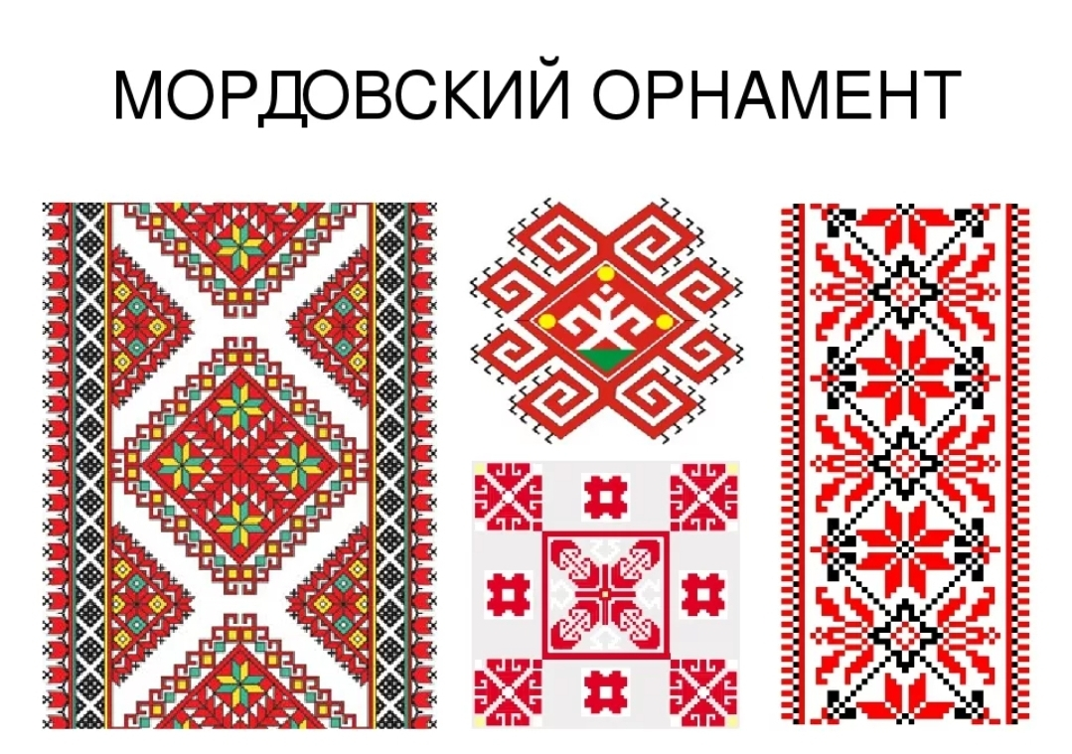
People and Culture
Who Lives in Mordovia?
Mordovia is a multi-national republic. Different people live here together in friendship.
Main peoples of the republic: The Moksha and the Erzya (together they are called Mordvins). They have very beautiful and ancient traditions!
Russians, Tatars, and many others also live here.
Mordovian costumes are very bright, with coins and embroidery.

Slide 3
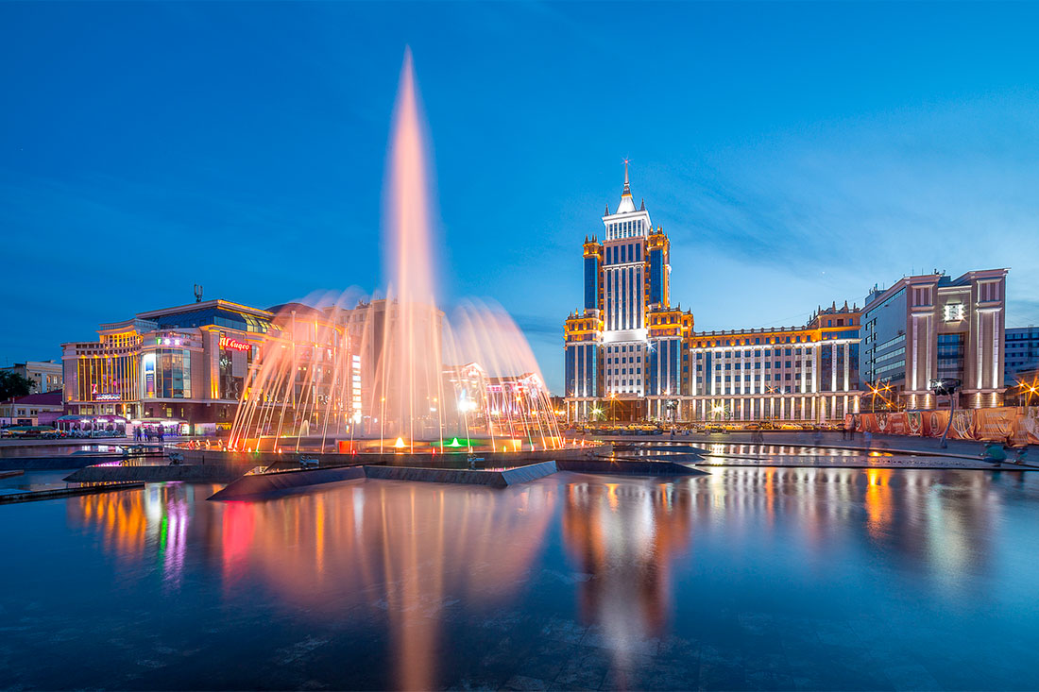
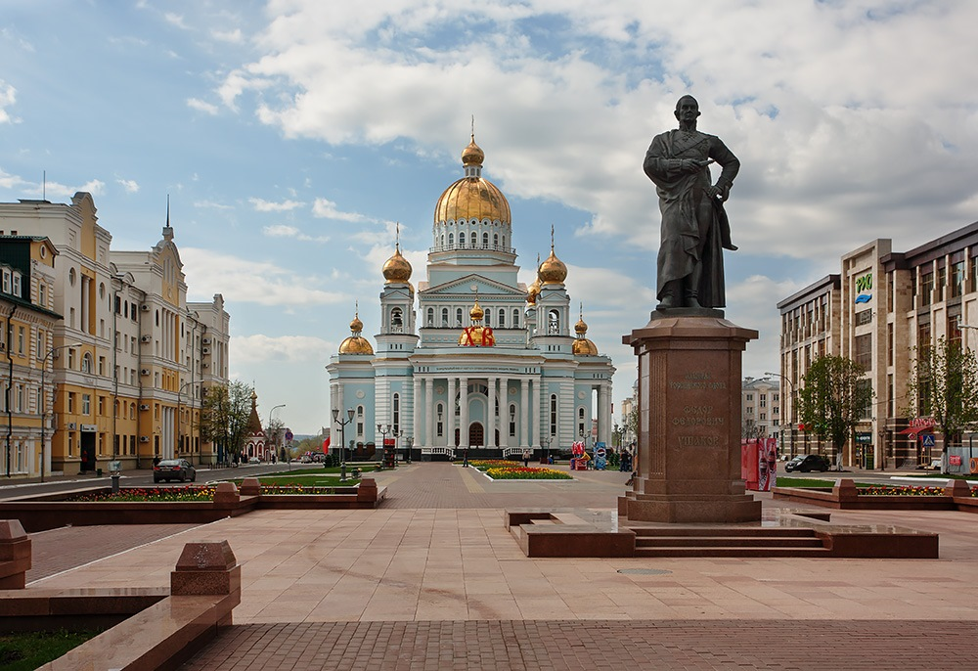
The Capital of Mordovia
The capital of Mordovia is the city of Saransk.
Saransk is a clean and cozy city.
Saransk - A Sporty and Beautiful City
In 2018, it hosted matches of the FIFA World Cup! A modern stadium, Mordovia Arena, was built for this.
The city has many fountains, parks, and beautiful monuments.
One of the largest and most beautiful cathedrals in Russia is the Cathedral of St. Feodor Ushakov.

Slide 4
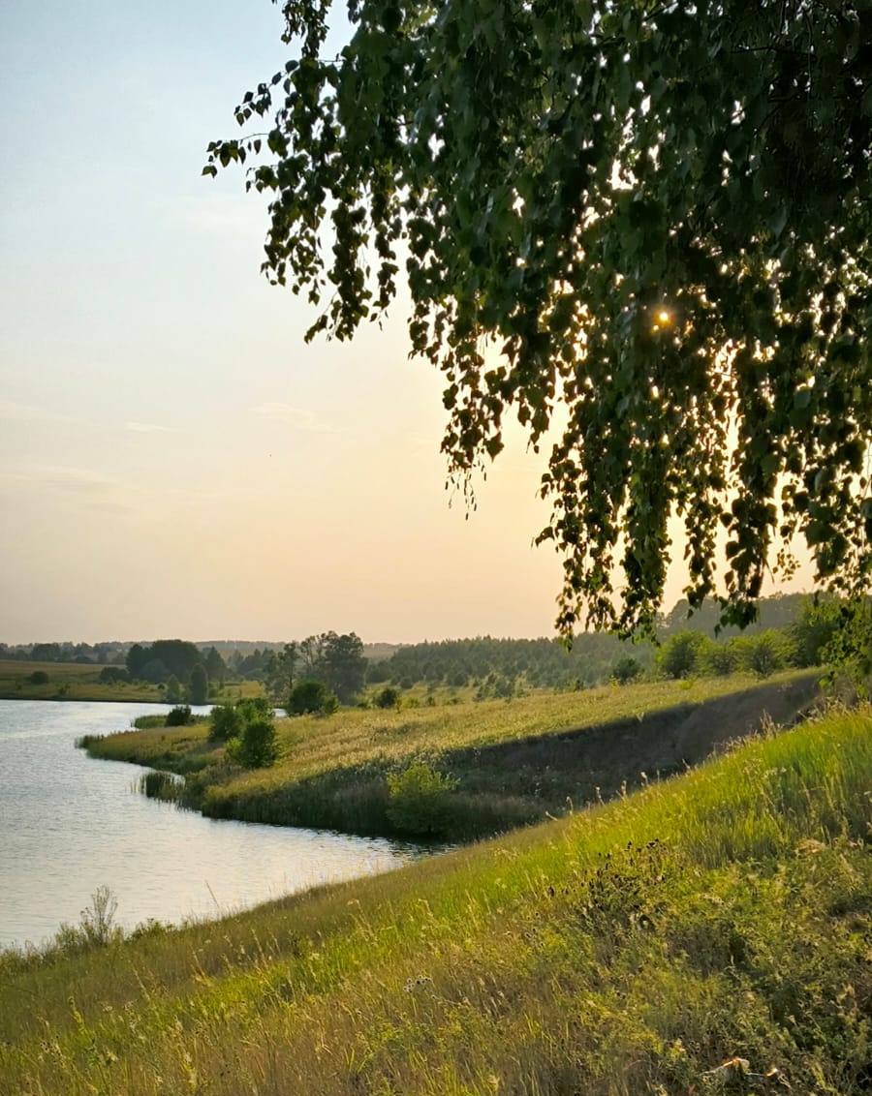
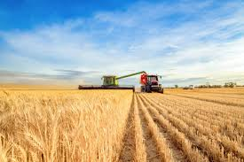
The nature of Mordovia
The nature of Mordovia is beautiful and diverse. Vast forests, peaceful rivers, and fertile fields cover its land. These rich natural resources have shaped the republic's traditional way of life. For centuries, agriculture has been the heart of its economy. That is why Mordovia is often called an agrarian region. Its fields yield wheat, rye, potatoes, and other crops, while its farms raise cattle.

Slide 5
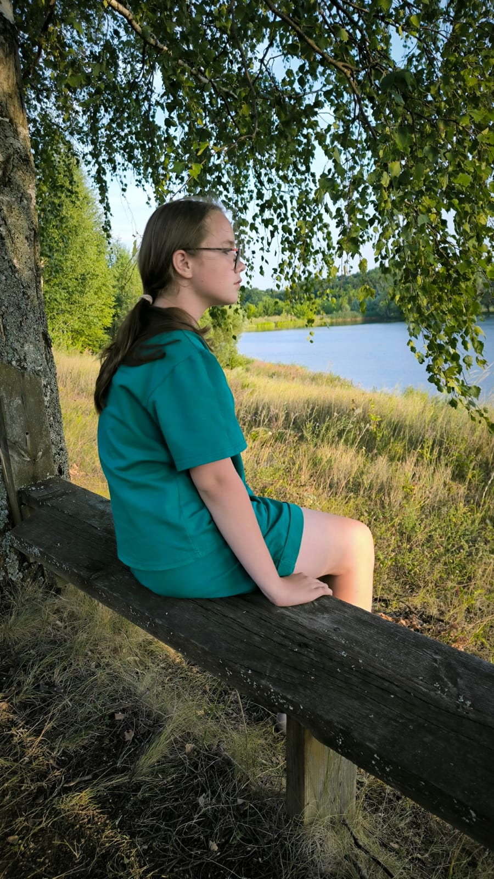
I love Mordovia!!
There's nothing better than spending my summer at my grandparents' place in Mordovia. I like it there so much! It has a special feeling — It smells of freshly cut grass and homemade pies, and I feel completely at home. I miss our evenings sitting on the porch and working together in the vegetable garden. So of course I'm going to visit them this summer!

